Slide 1
B.Tech IoT Programming
Project Report on
Smart Cane For Visually Impaired People Using Arduino
By
Group Leader:
Saumya(123102048) 123102048@nitkkr.ac.in 7895725200
Other Team Members:
Guruveer Singh(123102058) 123102058@nitkkr.ac.in 8569829681
Sanjana Meena(123102054) 123102054@nitkkr.ac.in 9625416272
Sanyam Singh(123102060) 123102060@nitkkr.ac.in 7419904016
Branch: CS-A
Subject: IoT Programming (CSPC 209)

Slide 2
ABSTRACT
The Smart Cane is designed for the visually impaired people to make their day to day life easier and safer enhancing their mobility and safety by detecting obstacles .
Key features of our project are Obstacle Detection, Emergency Support, Vibration notifications, Real time alerts and Battery Management for our user.
Overall, this project aims to empower visually impaired users navigating the world with 70% accuracy in object detection.
Important Keywords:
IoT(Internet of Things), Obstacle Detection, wireless connectivity, GPS Navigation and Real-Time Feedback

Slide 3
1.Introduction
Many people rely on self-mobility, but for the visually impaired, it can be very challenging. According to the WHO, over 285 million people worldwide are visually impaired, with 39 million being completely blind. In many places, tools to help the blind navigate are either unavailable, underdeveloped, or too expensive. This emphasizes the need for an affordable and effective smart service to assist the blind in general.
Motivation Behind the Project:
Enhancing Mobility and Improving Safety: Most visually impaired people for instance suffer a lot of hindrance in their day to day life, especially when it comes to movement.
Accessibility and Affordability: Most of the current supports are costly, and thus unavailable to the wider population.
Integration with Modern Technology: The incorporation of Bluetooth, GPS and mobile application integration into a smart cane may add value to other features like safety alerts which the others cannot provide.
Empowering Users: This can remarkably positively transform their lives by granting them more liberty and assertiveness.

Slide 4
Why This Project is Necessary?
Several Technological solutions had been developed over the years, but a large proportion of the visually impaired people use assistive devices such as simple canes or dogs’ guide.
Combining Internet of Things (IoT) and wireless communication offers an additional support for a smart blind cane in the long term to enhance the safety and reliability of the user.
According to sample research, visually impaired persons are involved in as many as 60% more accidents during their independent movement due to hidden obstacles.
However, these risks rises especially for the urban area since the environment is already so complex like crowded roads and speedy cars. Therefore, there always are people who need help in their daily activities.

Slide 5
SMART CANE: INTRODUCTION
The Smart Cane is designed for easy use and protection of the visually impaired individuals. Therefore we propose to combine the modern technology with a smart cane and transforming it into something that would make users more independent and be able to walk with assurance.
The Smart Blind Stick is designed to help users detect obstacles, navigate complex environments, and help themselves in emergencies. It integrates multiple sensors, real-time data processing and audio alerts.

Slide 6
Technical Details:
The Smart Cane has alerts that help keep users safe and informed.
1. Sensors:
Ultrasonic Sensors: These sensors emit ultrasonic waves, measures the distance of obstacle from the user and can trigger the buzzer.
2. Microcontroller:
Arduino : Acts as the brain of the Smart Cane, processing data from the sensors and managing other components.
3. Communication Modules:
Bluetooth Module: Enables the Smart Cane to connect to a smartphone app for navigation and emergency SOS functions.
The module facilitates real-time data exchange between the cane and the app.
4. GPS Module:
GPS Receiver: Provides location data for navigation in terms of latitude and longitude.
Therefore, helps in outdoor navigation by providing real-time location updates.
5. Smartphone App:
Emergency Contacts Setup: Users can configure emergency contacts who will receive SOS messages in case of an emergency.
Battery Monitoring: Sends alert when below 15%.

Slide 7
UNIQUE FUNCTIONALITY:
360-degree Detection:
The main specificity of our project as a whole is that we implement 360-degree detection. This approach provides better secure navigation and makes the device capable of identifying obstacles from every angle since it can sense 360-degree surrounding environment for the blind user.
Affordable and Scalable:
Using easily available components like Arduino,modules and MacroDroid(Mobile App) makes the project cost effective.
Connectivity and Tracking:
Use of GPS module for real time location tracking and Bluetooth module allows the cane to connect to smartphone and can enable real time alerts and much more functionalities like emergency SOS and battery monitoring.

Slide 8
2.RELATED WORK IN PROJECT
The MIT Smart Cane, developed in 2020, is a significant advancement in assistive technology for the visually impaired. It combines ultrasonic sensors, LiDAR, and real-time GPS to enhance obstacle detection and navigation, both indoors and outdoors. LiDAR creates 3D maps of the environment, while ultrasonic sensors detect short- and long-range obstacles. The cane also offers GPS-enabled route planning and voice-guided feedback, making navigation intuitive for users.
Despite its multiple features, the high cost of LiDAR and it’s real world limited testing are some significant challenges. Also,the refinement is needed to make the cane more affordable and accessible to a broader audience. Overall, the MIT Smart Cane showcases cutting-edge technology with potential to greatly improve mobility for visually impaired individuals.

Slide 9
Author | Link of Published Work( Research Paper/Patent) | year | Data features | Model/ Sensors Used | Results | Drawbacks in their project
MIT Smart Cane | https://www.csail.mit.edu/news/wearable-system-helps-visually-impaired-users-navigate | 2020 | Ultrasonic, GPS, LiDAR | Ultrasonic Sensors, LiDAR, Real Time GPS | Enhanced navigation with LiDAR and real time feedback | Limited field tests, high cost of LiDAR integration
IIT Delhi vision-free Cane | https://www.business-standard.com/article/pti-stories/iit-delhi-develops-smart-canes-for-visually-impaired-114033100665_1.html | 2021 | SONAR, Vibration Feedback | SONAR sensors, Vibration mechanism | Cost effective, vibration feedback to detect obstacle | Limited obstacle range detection and feedback speed

Slide 10
Drawbacks in these projects:
1. High Technology Costs:
For example, the MIT Smart Cane is designed to make use of cutting-edge technologies like LiDAR and other advanced sensors which leads to high manufacturing costs.
2. Limited Real-world Testing:
As much as the MIT cane is an innovative success, and is used successfully in a controlled environment, it has yet to be tested out in real-world conditions – on busy urban streets or the rain, or coming to terms with the rough terrain. This calls into question their ability to get works in a variety of environments.
3.Obstacle Detection Limitation:
IIT Delhi's Smart Cane uses ultrasonic sensors to detect obstacles above knee level, it struggles with smaller or faster-moving objects, which could potentially reduce user safety.

Slide 11
3.PROJECT
Smart Cane for blind people is an extraordinary Internet of Things project that focuses on improving contact and interdependence. Combining a modern element of IT innovation with a humble walking stick, we upgrade the object into an enhanced tool that greatly enhances the effectiveness of the user and their orientation.
HOW IT WORKS?
Obstacle Alert:
The Smart Cane uses three ultrasonic sensor to detect obstacles at different angles. This avoids collision with different objects and makes it fully safe.
Wireless Communication:
The Smart Cane has a Bluetooth module which enables wireless communication using Macrodriod for mobile phone having features like emergency SOS and real time alerts.
Navigation:
With the help of a GPS module, the Smart Cane helps the user navigate through Bluetooth it can link with a smartphone so that the users can conveniently orient themselves in rather challenging space.

Slide 12
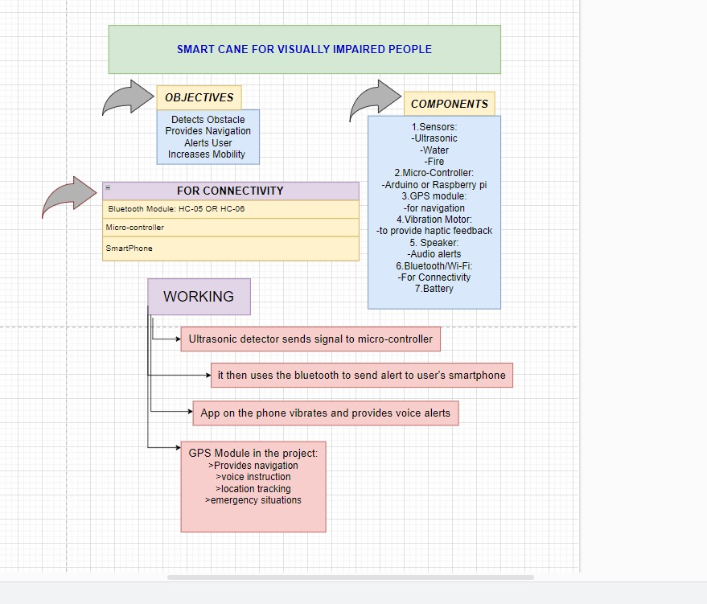
3.1 Conceptual Design Diagram

Slide 13
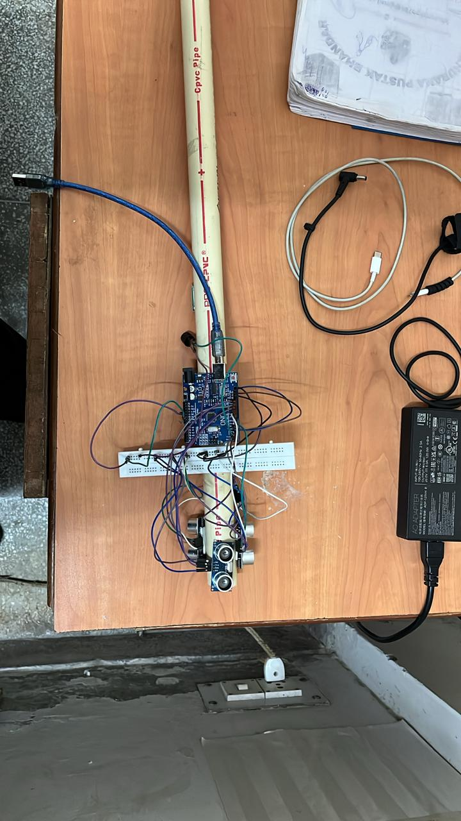
REAL TIME PHOTOGRAPH
OF WORKING PROJECT:
.

Slide 14
4.EXPERIMENTAL SETUP:
4.1 Implementation Details: The hardware and Software components utilized in the development of the smart cane are given below with details of each component used.
COMPONENT | DESCRIPTION
Microcontroller | Arduino uno
Ultrasonic Sensor | 3 HC-SR04 sensors for obstacle detection
Bluetooth Module | HC-05 for wireless communication with smartphone
GPS Module | Neo-6M module for navigation
USB cable | Providing the sufficient power supply needed by Arduino to work
Buzzer | the buzzer serves as an essential feedback mechanism for the user
Software | Arduino IDE for programming; Macro-Droid for mobile app features

Slide 15
4.2 Experimental Results:
TESTS | RESULTS | REMARKS
OBSTACLE DETECTION | detects obstacle within 50cm distance | Can easily detect object of comparable size
BLUETOOTH CONNECTIVITY | Stable connection within 10m | Considers encryption for secure data transfer
BUZZER RESPONSE | Activates immediately upon detection | Beeps within 1 to 2s which can be audible clearly
GPS MODULE PERFORMANCE | - | It has been set up to give GPS data in the form of latitude and longitude

Slide 16
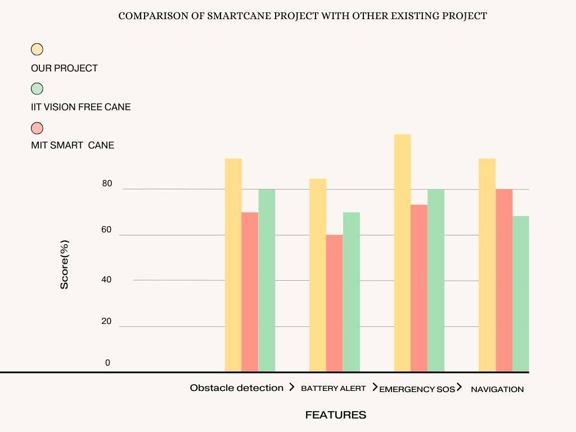
5.Comparison with existing work

Slide 17
6.CONCLUSION AND FUTURE WORK
FUTURE WORK:
Advanced Obstacle Detection — Attach more sensors like IR or even LIDAR which provides a different image of obstacles and allowing it to distinguish between obstacles (staircases, potholes).
Voice Guidance: Add a voice module for voice feedback and navigation so users can better understand their environment.
Machine Learning: Using ML algorithms to learn the user’s walking behavior.
CONCLUSION:
As a summary, our smart cane project with Arduino and ultrasonic sensors helps visually impaired people by detecting obstacles 360-degree. The addition of haptic feedback allows users to navigate their environment with an attention and mobility, giving users a better experience.
This project really highlights the possibilities of IoT in assistive technology and open a way for further creations intended to help visually impaired more day by day.
REFERENCES:
1] Statista. "Internet of Things (IoT) - Statistics & Facts." Accessed October 4, 2024. Statista.
[2] Chen, J., An, J., Lyu, H., Kanan, C., & Luo, J. (2024). "Learning to Evaluate the Artness of AI-generated Images." IEEE Transactions on Multimedia.
[3] Business Standard. "IIT Delhi’s Vision-Free Cane for the Visually Impaired." Accessed October 4, 2024. Business Standard.
[4] YourStory. "This Smart Cane is a Game Changer for the Visually Impaired." Accessed October 4, 2024. YourStory.
[5] MIT Media Lab. "Smart Cane." Accessed October 4, 2024. MIT Media Lab.

